Slide 2
Assignment instruction link (display whole directory contents)
https://www.dj4e.com/assn/dj4e_html.md

Slide 3
Make 2 new folders
mkdir ~/django_projects/mysite/site
mkdir ~/django_projects/msite/site/subfolder

Slide 4
Create file
Create file at ~/django_projects/mysite/site/hello.txt with the text “Hello World”
Create file at ~/django_projects/mysite/site/subfolder/hello.html with the text
<h1>Hello there!</h1>

Slide 5
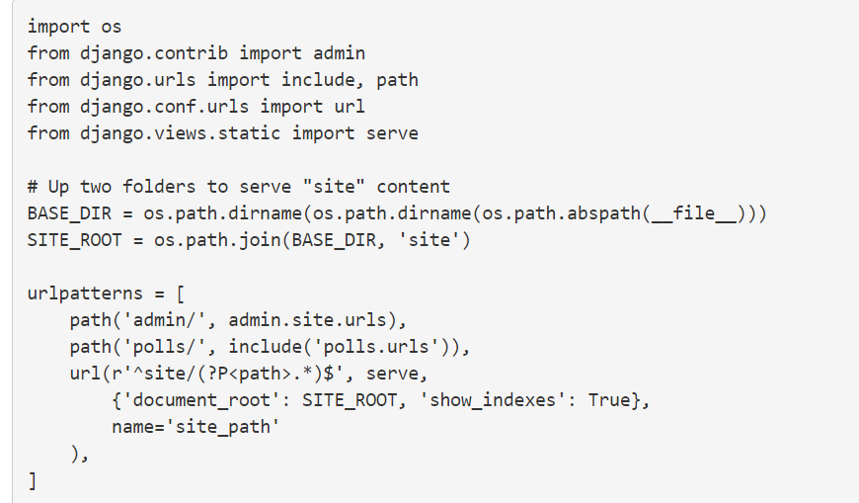
Change ~/django_projects/mysite/mysite/urls.py

Slide 6
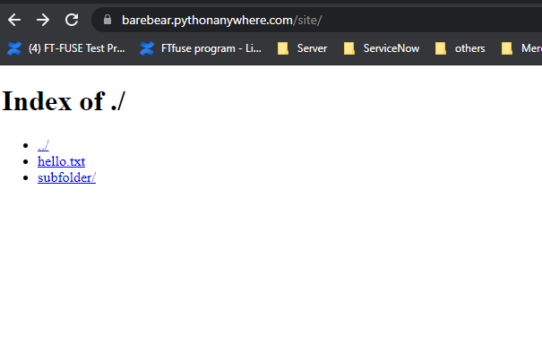
Final result (xxx.pythonanywhere.com/site)

